Slide 1
4750 N. Sheridan Road Chicago, IL 60640 Terry Bergdall

Slide 2
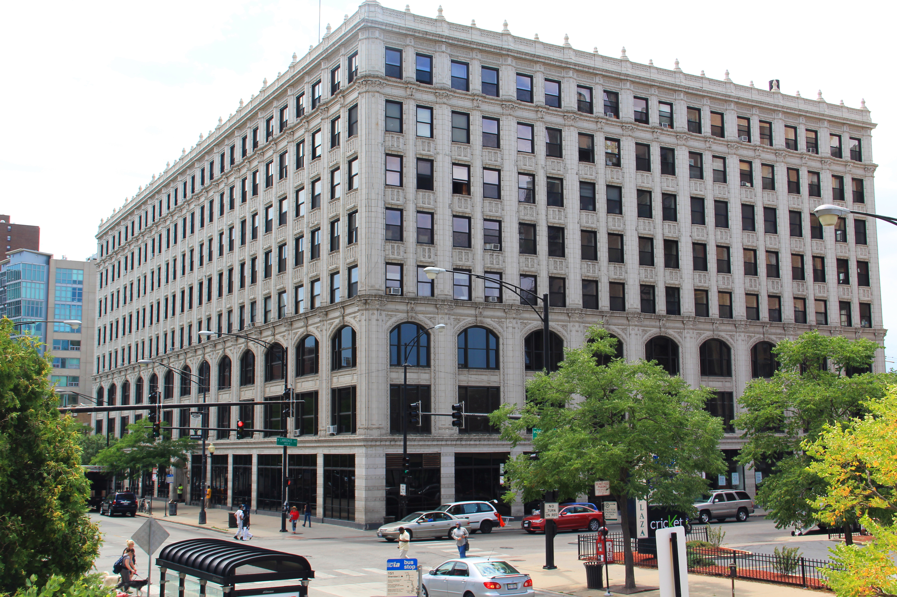

Slide 3
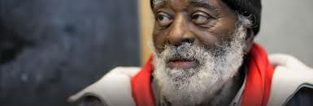

Slide 4
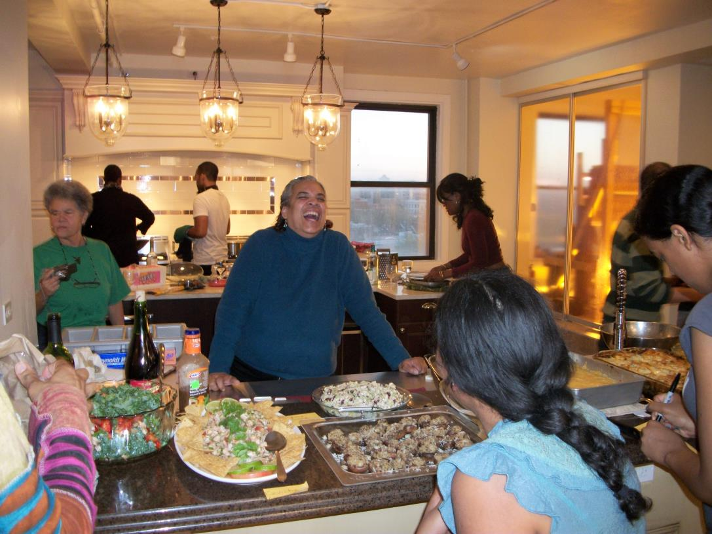
Intentional Residential Community

Slide 5
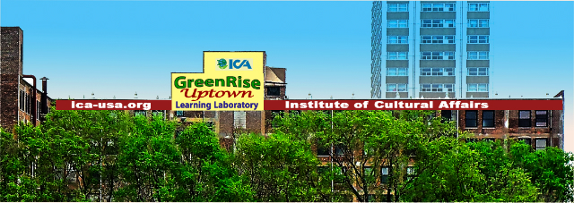
Retrofit Chicago Retrofit Commercial
Buildings Initiative
Landmark Status
Comprehensive Lights Retrofit
Solar Project with grant from ICECF
Controlled experiment -- Bioshaft

Slide 6
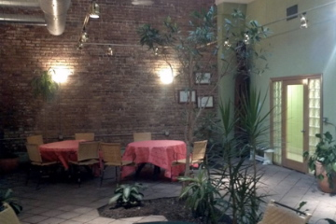
beyond technical, a green culture

Slide 7
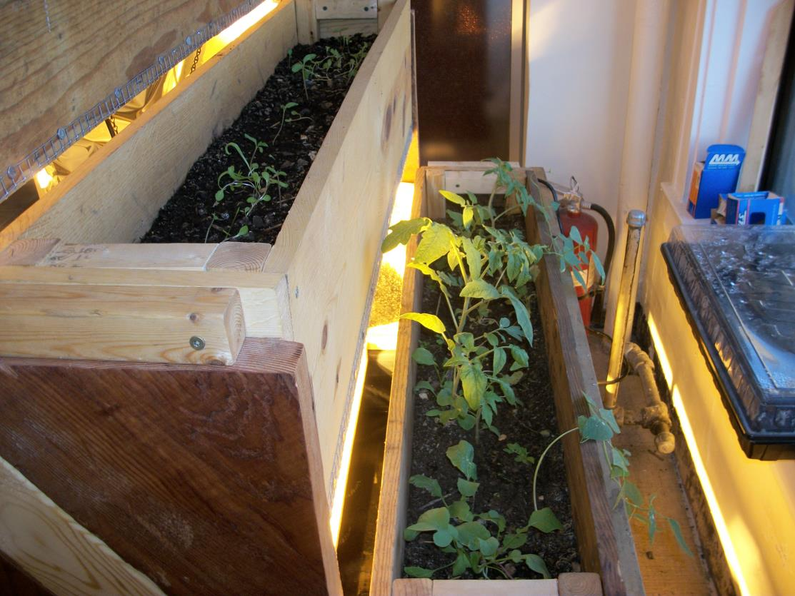
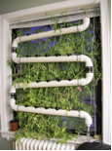
window garden, kitchen greenhouse

Slide 8
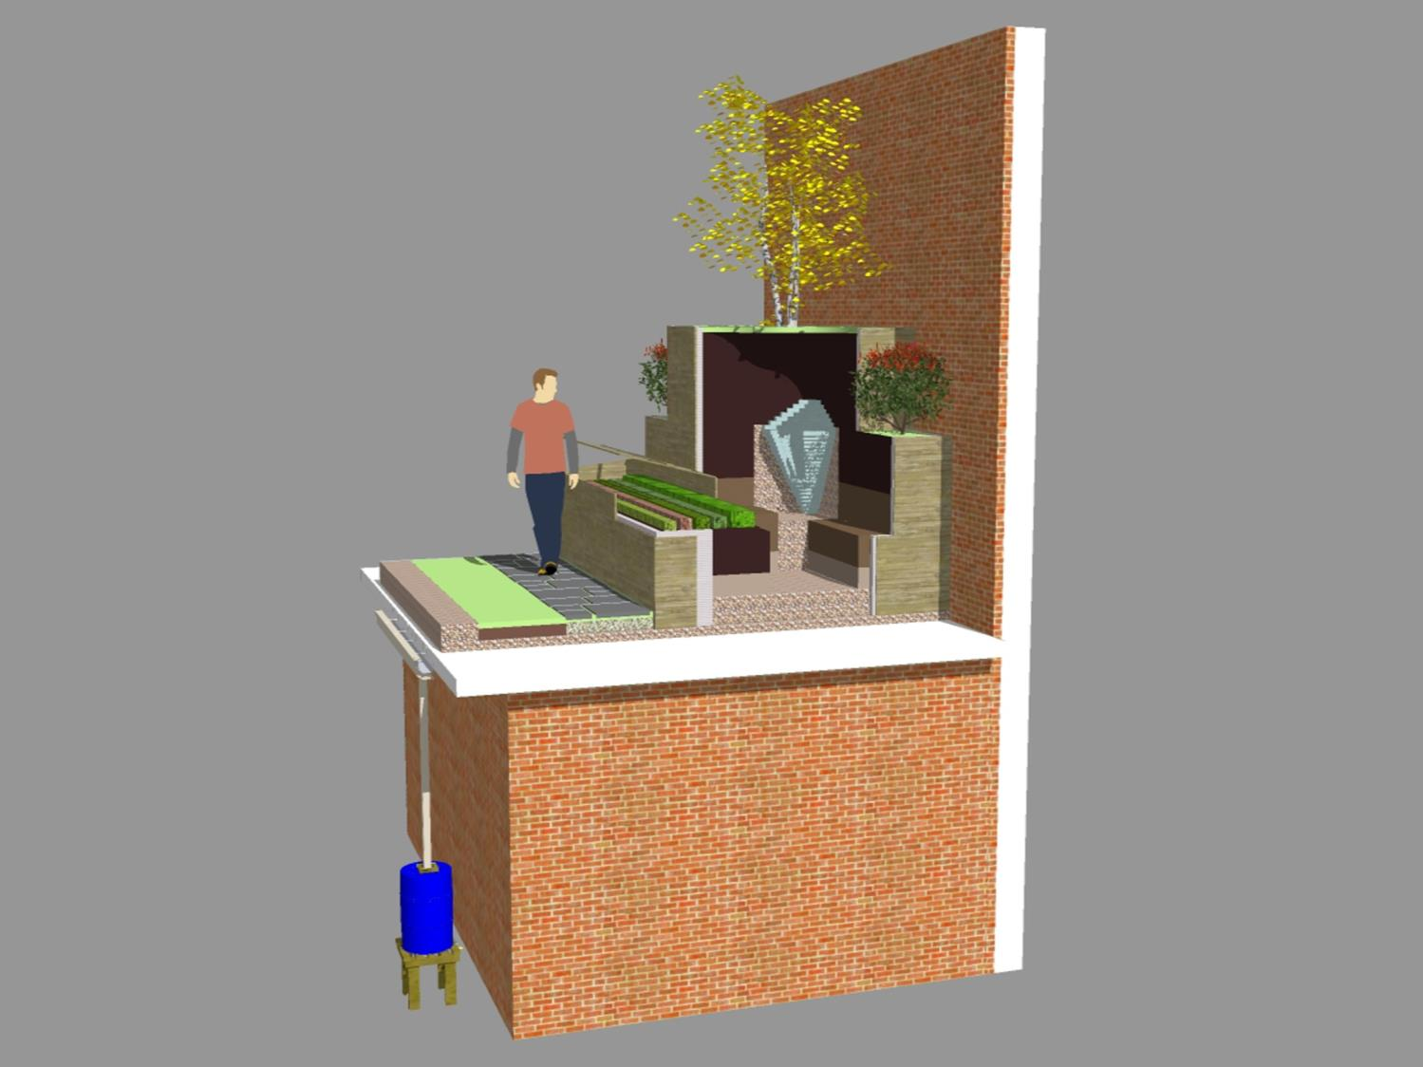
Phase 1 – Pilot Project
Process steps
evapotranspiration
Black water
from toilet
Digestive
fermentation
and uptake
of nutrients
Geochemically
filtered water
Water collected
in rain barrel
will undergo
testing
Notes:
The process steps for the first phase of the pilot project are:
Blackwater from bathroom is discharged into the receptacle where it is digested and distributed into the soil layers, for uptake by plants.
Evapotranspiration will displace some of the water back into the atmosphere and in the process cooling the immediate surroundings, helping to offset the urban heat island effect.
Once the water has percolated and is geochemically filtered by the soil layers, the excess liquid will be distributed through the green roof section where additional uptake of nutrients and filtration will occur.
The remnant flow will be collected in a rain barrel and tested for quality before used to water potted plants.
Modifications may be made to the bioshaft unit to improve results.

Slide 9
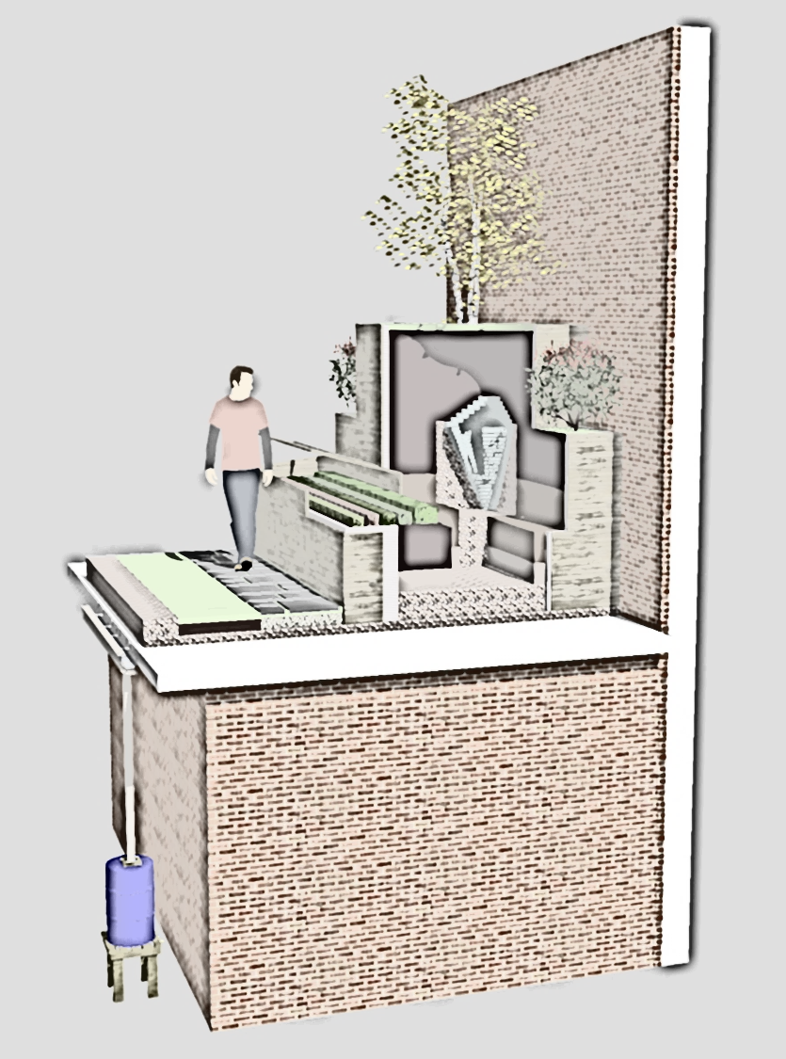
The process steps for the first phase of the pilot project are:
Blackwater from bathroom is discharged into the receptacle where it is digested and distributed into the soil layers, for uptake by plants.
Evapotranspiration will displace some of the water back into the atmosphere and in the process cooling the immediate surroundings, helping to offset the urban heat island effect.
Once the water has percolated and is geochemically filtered by the soil layers, the excess liquid will be distributed through the green roof section where additional uptake of nutrients and filtration will occur.
The remnant flow will be collected in a rain barrel and tested for quality before used to water potted plants.
Modifications may be made to the bioshaft unit to improve results.

Slide 10
Horse Manure (each weighted and placed in microcosm)
DePaul Students
(Spring 2013) working on Bioshaft microcosms.

Slide 11
Uptown community engagement
Continued in Part 2

